Slide 1
This Talk
1) Node embeddings
Map nodes to low-dimensional embeddings.
2) Graph neural networks
Deep learning architectures for graph-structured data
3) Applications

Slide 2
Part 1:
Node Embeddings

Slide 3
Embedding Nodes
Input
Output
Intuition: Find embedding of nodes to d-dimensions so that “similar” nodes in the graph have embeddings that are close together.

Slide 4
Setup
Assume we have a graph G:
V is the vertex set.
A is the adjacency matrix (assume binary).
No node features or extra information is used!

Slide 5
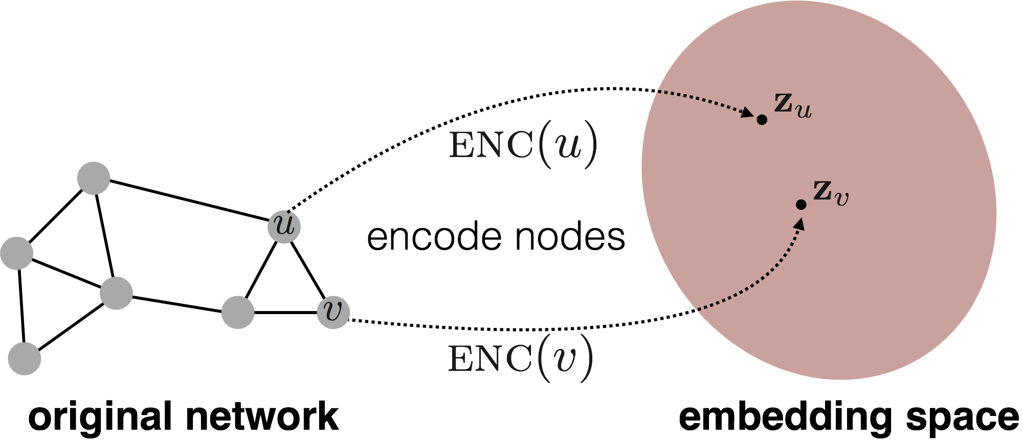
Embedding Nodes
Goal is to encode nodes so that similarity in the embedding space (e.g., dot product) approximates similarity in the original network.

Slide 6
Embedding Nodes
Goal:
Need to define!

Slide 7
Learning Node Embeddings
Define an encoder (i.e., a mapping from nodes to embeddings)
Define a node similarity function (i.e., a measure of similarity in the original network).
Optimize the parameters of the encoder so that:
Notes:
Note that other distance measures other than dot products could be used (e.g., Euclidean distance), but the dot product is the standard measure of similarity used.

Slide 8
Two Key Components
Encoder maps each node to a low-dimensional vector.
Similarity function specifies how relationships in vector space map to relationships in the original network.
d-dimensional embedding
node in the input graph
Similarity of u and v in the original network
dot product between node embeddings
Notes:
Note again that other distance measures other than dot products could be used (e.g., Euclidean distance), but the dot product is the standard measure of similarity used.

Slide 9
“Shallow” Encoding
Simplest encoding approach: encoder is just an embedding-lookup
matrix, each column is node embedding [what we learn!]
indicator vector, all zeroes except a one in column indicating node v

Slide 10
“Shallow” Encoding
Simplest encoding approach: encoder is just an embedding-lookup
embedding vector for a specific node
embedding matrix
Dimension/size of embeddings
one column per node

Slide 11
“Shallow” Encoding
Simplest encoding approach: encoder is just an embedding-lookup.
i.e., each node is assigned a unique embedding vector.
E.g., node2vec, DeepWalk, LINE

Slide 12
“Shallow” Encoding
Simplest encoding approach: encoder is just an embedding-lookup.
We will focus on shallow encoding in this section…
After the break we will discuss more encoders based on deep neural networks.

Slide 13
How to Define Node Similarity?
Key distinction between “shallow” methods is how they define node similarity.
E.g., should two nodes have similar embeddings if they….
are connected?
share neighbors?
have similar “structural roles”?
…?

Slide 14
Outline of This Section
Adjacency-based similarity
Multi-hop similarity
Random walk approaches
High-level structure and material from:
Hamilton et al. 2017. Representation Learning on Graphs: Methods and Applications. IEEE Data Engineering Bulletin on Graph Systems.

Slide 15
Adjacency-based Similarity
Material based on:
Ahmed et al. 2013. Distributed Natural Large Scale Graph Factorization. WWW.

Slide 16
Adjacency-based Similarity
Similarity function is just the edge weight between u and v in the original network.
Intuition: Dot products between node embeddings approximate edge existence.
loss (what we want to minimize)
embedding similarity
(weighted) adjacency matrix for the graph
sum over all node pairs

Slide 17
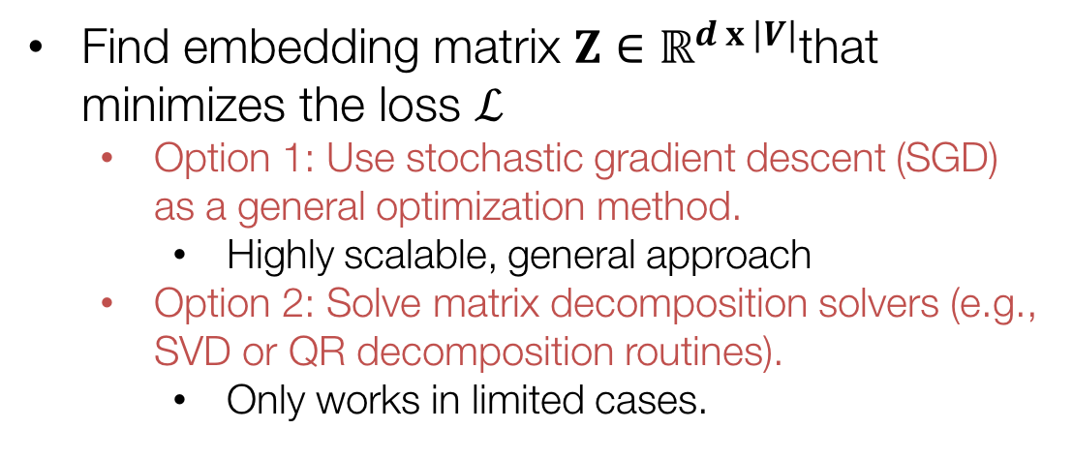
Adjacency-based Similarity
Find embedding matrix $Z∈ℝ^{d x |V|}$that minimizes the loss $ℒ$
Option 1: Use stochastic gradient descent (SGD) as a general optimization method.
Highly scalable, general approach
Option 2: Solve matrix decomposition solvers (e.g., SVD or QR decomposition routines).
Only works in limited cases.

Slide 18
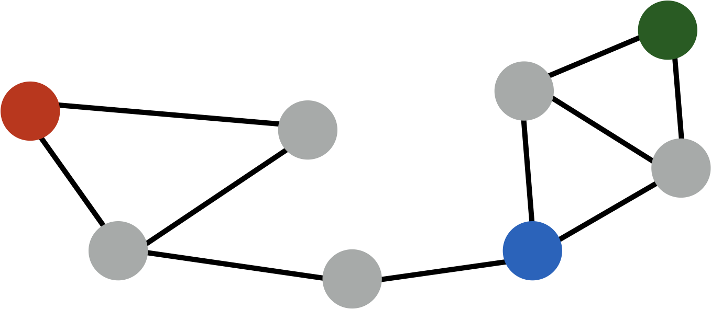
Adjacency-based Similarity
Drawbacks:
O(|V|²) runtime. (Must consider all node pairs.)
Can make O([E|) by only summing over non-zero edges and using regularization (e.g., Ahmed et al., 2013)
O(|V|) parameters! (One learned vector per node).
Only considers direct, local connections.
e.g., the blue node is obviously more similar to green compared to red node, despite none having direct connections.

Slide 19
Multi-hop Similarity
Material based on:
Cao et al. 2015. GraRep: Learning Graph Representations with Global Structural Information. CIKM.
Ou et al. 2016. Asymmetric Transitivity Preserving Graph Embedding. KDD.

Slide 20
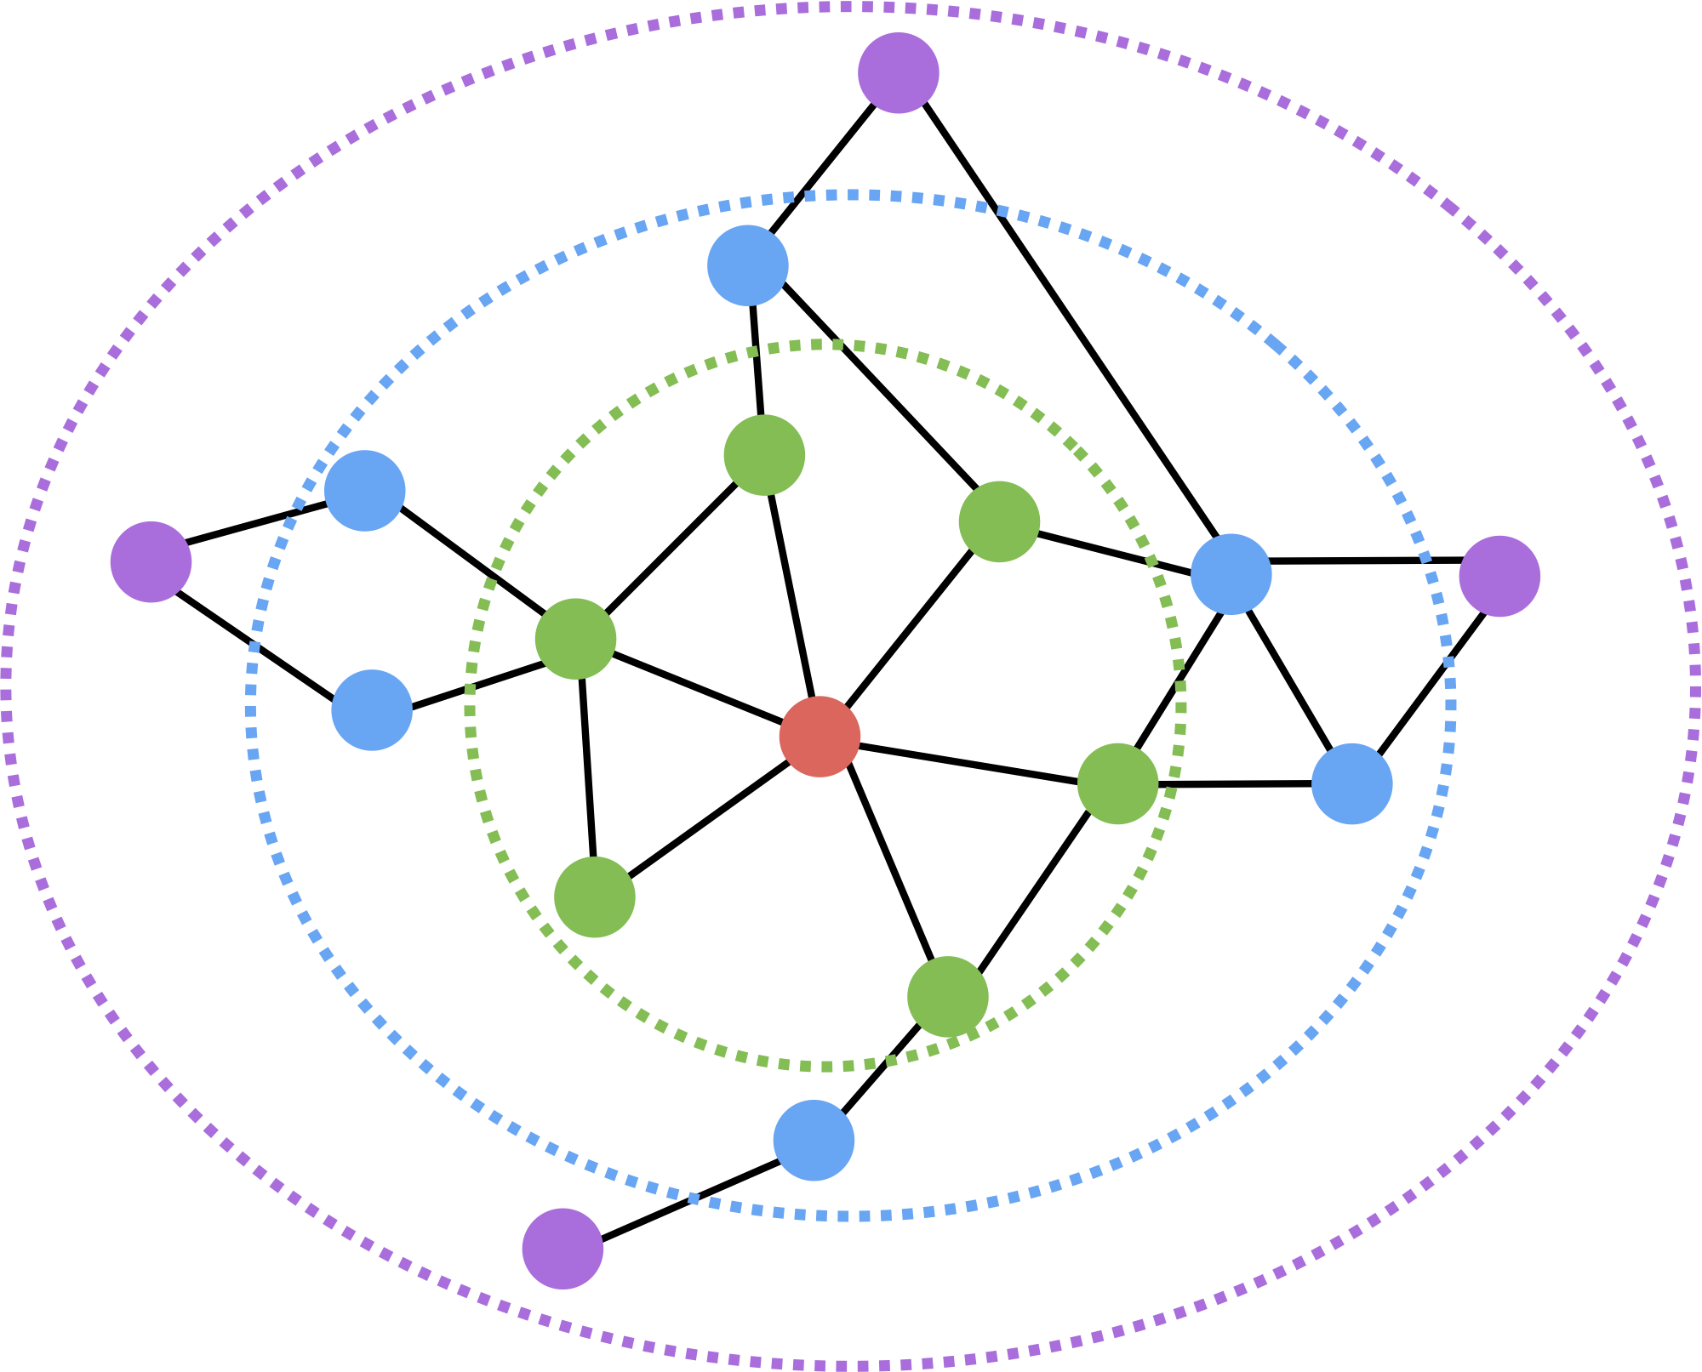
Multi-hop Similarity
Idea: Consider k-hop node neighbors.
E.g., two or three-hop neighbors.
Red: Target node
Green: 1-hop neighbors
A (i.e., adjacency matrix)
Blue: 2-hop neighbors
A²
Purple: 3-hop neighbors
A³

Slide 21
Multi-hop Similarity
Basic idea:
Train embeddings to predict k-hop neighbors.
In practice (GraRep from Cao et al, 2015):
Use log-transformed, probabilistic adjacency matrix:
Train multiple different hop lengths and concatenate output.
node degree
constant shift
Notes:
The max with 0 and the constant shift etc can be viewed as regularization. We only pay attention to nodes that have significantly high multi-hop adjacency counts. In probabilistic terms, this means that we have a high prior for nodes *not* being related.

Slide 22
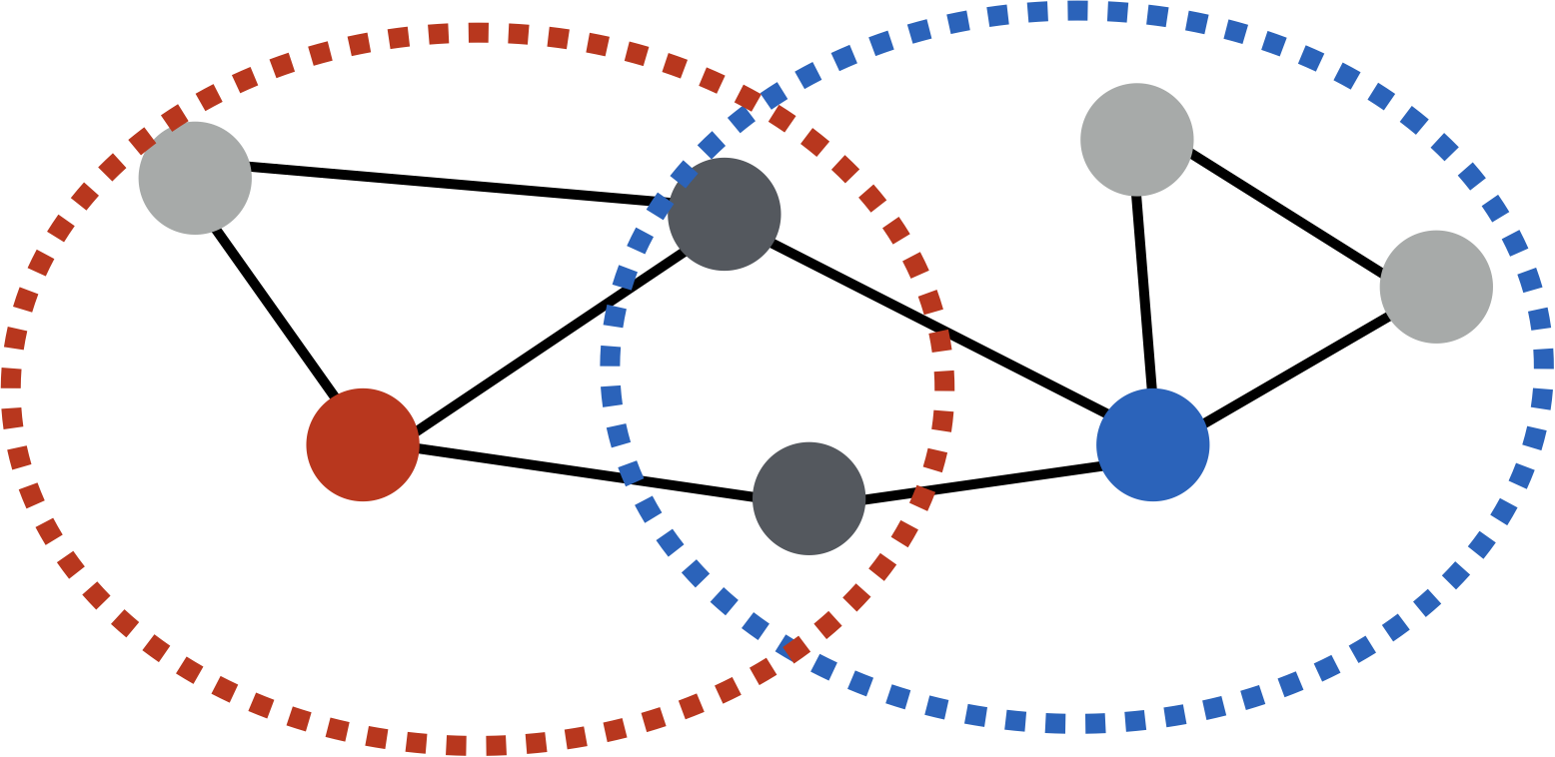
Multi-hop Similarity
Another option: Measure overlap between node neighborhoods.
Example overlap functions:
Jaccard similarity
Adamic-Adar score

Slide 23
Multi-hop Similarity
multi-hop network similarity (i.e., any neighborhood overlap measure)
embedding similarity
S_{u,v} is the neighborhood overlap between u and v (e.g., Jaccard overlap or Adamic-Adar score).
This technique is known as HOPE (Yan et al., 2016).

Slide 24
Summary so far
Basic idea so far:
1) Define pairwise node similarities.
2) Optimize low-dimensional embeddings to approximate these pairwise similarities.
Issues:
Expensive: Generally O(|V|²), since we need to iterate over all pairs of nodes.
Brittle: Must hand-design deterministic node similarity measures.
Massive parameter space: O(|V|) parameters

Slide 25
Random Walk Approaches
Material based on:
Perozzi et al. 2014. DeepWalk: Online Learning of Social Representations. KDD.
Grover et al. 2016. node2vec: Scalable Feature Learning for Networks. KDD.

Slide 26
Random-walk Embeddings
probability that u and v co-occur on a random walk over the network

Slide 27
Random-walk Embeddings
Estimate probability of visiting node v on a random walk starting from node u using some random walk strategy R.
Optimize embeddings to encode these random walk statistics.

Slide 28
Why Random Walks?
Expressivity: Flexible stochastic definition of node similarity that incorporates both local and higher-order neighborhood information.
Efficiency: Do not need to consider all node pairs when training; only need to consider pairs that co-occur on random walks.

Slide 29
Random Walk Optimization
Run short random walks starting from each node on the graph using some strategy R.
For each node u collect N_{R}(u), the multiset* of nodes visited on random walks starting from u.
Optimize embeddings to according to:
* N_{R}(u) can have repeat elements since nodes can be visited multiple times on random walks.

Slide 30
Random Walk Optimization
Intuition: Optimize embeddings to maximize likelihood of random walk co-occurrences.
Parameterize P(v | z_{u}) using softmax:

Slide 31
Random Walk Optimization
Putting things together:
sum over all nodes u
sum over nodes v seen on random walks starting from u
predicted probability of u and v co-occuring on random walk
Optimizing random walk embeddings =
Finding embeddings z_{u} that minimize L

Slide 32
Random Walk Optimization
But doing this naively is too expensive!!
Nested sum over nodes gives O(|V|²) complexity!!

Slide 33
Random Walk Optimization
But doing this naively is too expensive!!
The normalization term from the softmax is the culprit… can we approximate it?

Slide 34
Negative Sampling
Solution: Negative sampling
i.e., instead of normalizing w.r.t. all nodes, just normalize against k random “negative samples”
random distribution over all nodes
sigmoid function

Slide 35
Negative Sampling
random distribution over all nodes
Sample negative nodes proportional to degree.
Two considerations for k (# negative samples):
Higher k gives more robust estimates.
Higher k corresponds to higher prior on negative events.

Slide 36
Random Walks: Stepping Back
Run short random walks starting from each node on the graph using some strategy R.
For each node u collect N_{R}(u), the multiset of nodes visited on random walks starting from u.
Optimize embeddings to according to:
We can efficiently approximate this using negative sampling!

Slide 37
How should we randomly walk?
So far we have described how to optimize embeddings given random walk statistics.
What strategies should we use to run these random walks?
Simplest idea: Just run fixed-length, unbiased random walks starting from each node (i.e., DeepWalk from Perozzi et al., 2013).
But can we do better?

Slide 38
node2vec: Biased Walks
Idea: use flexible, biased random walks that can trade off between local and global views of the network (Grover and Leskovec, 2016).

Slide 39
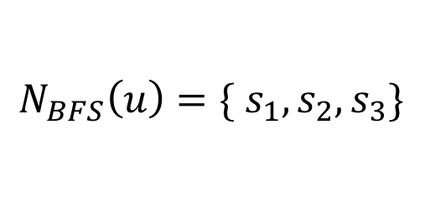
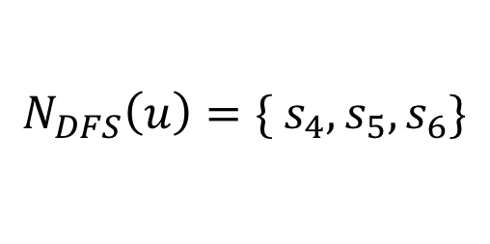
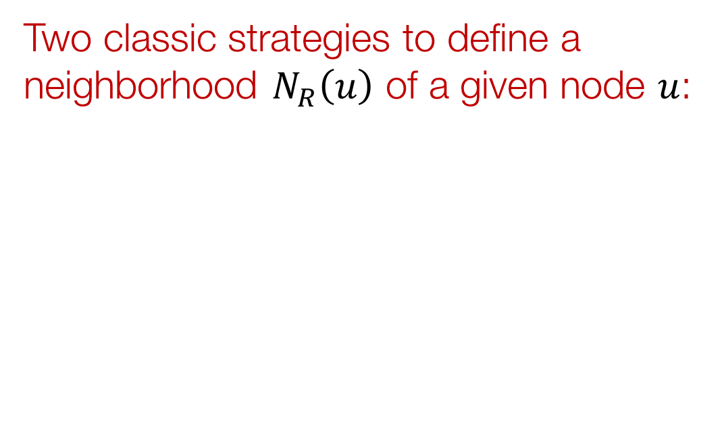
node2vec: Biased Walks
Two classic strategies to define a neighborhood $N_{R}\left(u\right)$ of a given node $u$:
$$N_{BFS}\left(u\right)=\{ s_{1},s_{2},s_{3}\}$$
Local microscopic view
$$N_{DFS}\left(u\right)=\{ s_{4},s_{5},s_{6}\}$$
Global macroscopic view

Slide 40
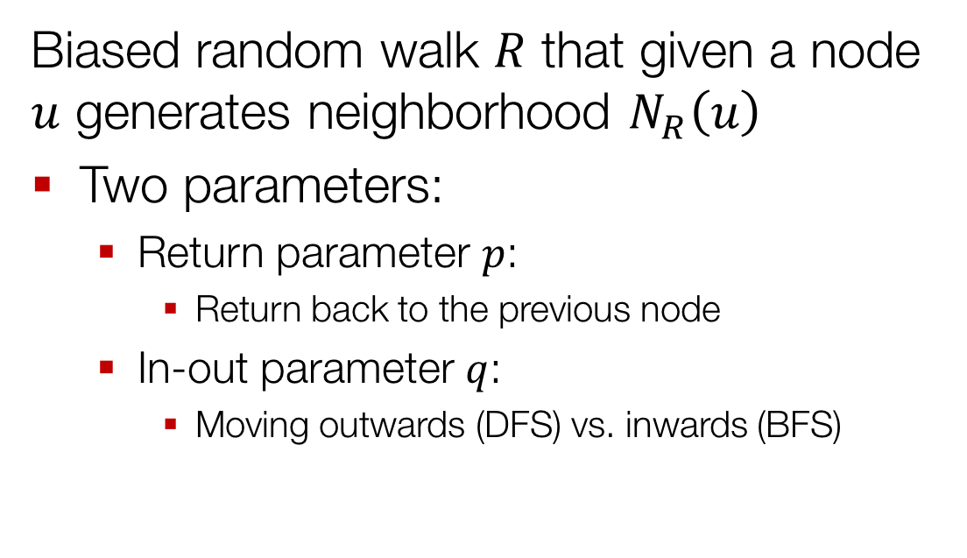
Interpolating BFS and DFS
Biased random walk $R$ that given a node $u$ generates neighborhood $N_{R}\left(u\right)$
Two parameters:
Return parameter $p$:
Return back to the previous node
In-out parameter $q$:
Moving outwards (DFS) vs. inwards (BFS)

Slide 41

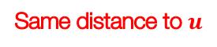
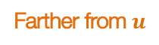
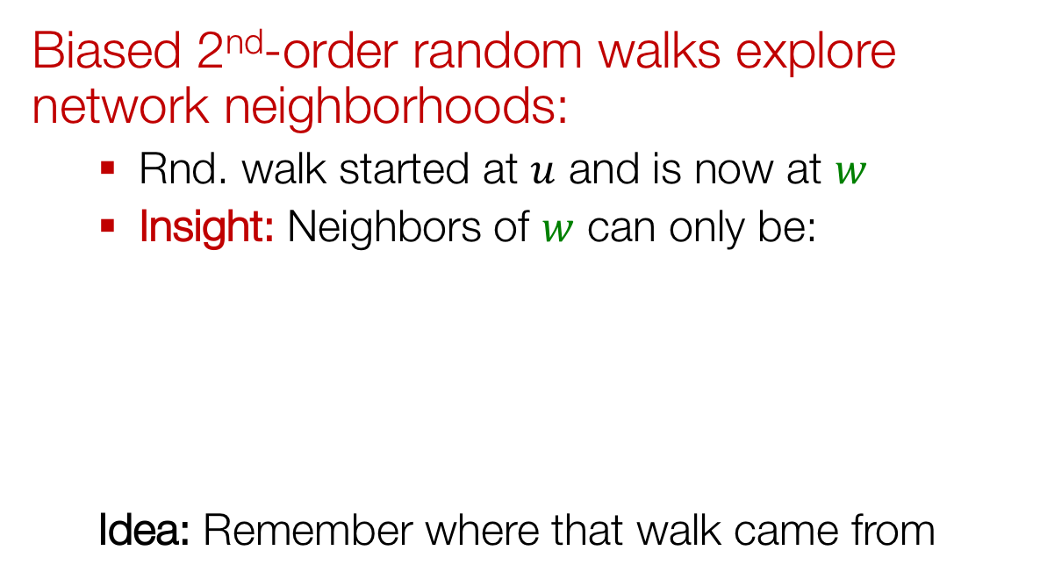
Biased Random Walks
Biased 2nd-order random walks explore network neighborhoods:
Rnd. walk started at $u$ and is now at $w$
Insight: Neighbors of $w$ can only be:
Idea: Remember where that walk came from
Same distance to $u$
s₂
s₃
w
Farther from $u$
u
s₁
Closer to $u$

Slide 42

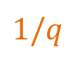
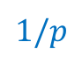
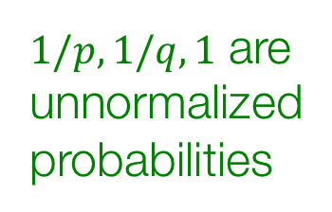
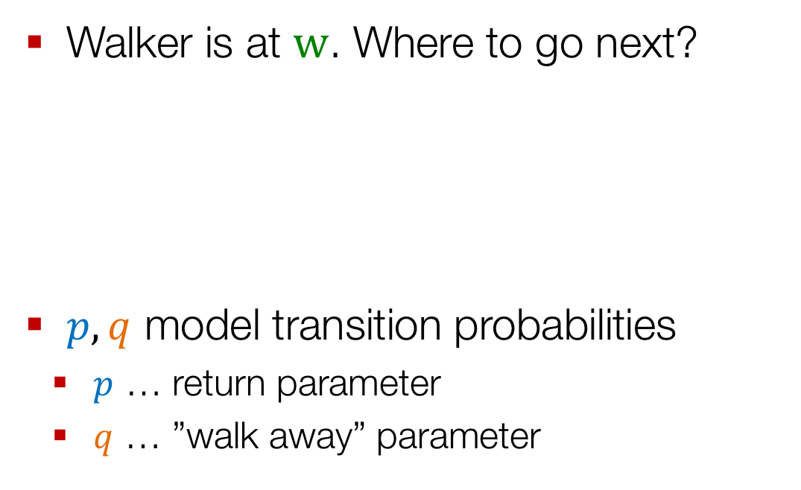
Biased Random Walks
Walker is at $w$. Where to go next?
$p,q$ model transition probabilities
$p$ … return parameter
$q$ … ”walk away” parameter
s₂
$$1$$
s₃
$1/p,1/q,1$ are unnormalized probabilities
w
$$1/q$$
u
s₁
$$1/p$$

Slide 43
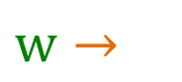
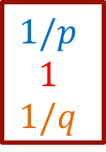
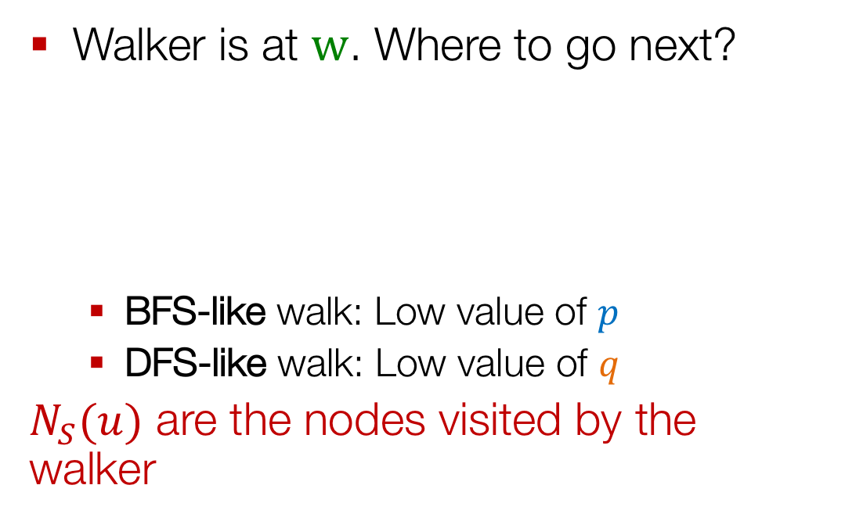
Biased Random Walks
Walker is at $w$. Where to go next?
BFS-like walk: Low value of $p$
DFS-like walk: Low value of $q$
$N_{S}(u)$ are the nodes visited by the walker
s₂
$$1$$
s₃
s₁ s₂ s₃
$$1/p$$
$$1$$
$$1/q$$
w
$w→$
$$1/q$$
u
s₁
$$1/p$$
Unnormalized transition prob.
Unnormalized transition prob.

Slide 44
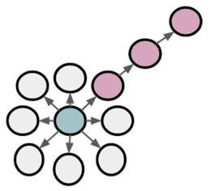
BFS vs. DFS
u
BFS:
Micro-view of neighbourhood
DFS:
Macro-view of neighbourhood

Slide 45
Experiments: Micro vs. Macro
Interactions of characters in a novel:
p=1, q=2
Microscopic view of the network neighbourhood
p=1, q=0.5
Macroscopic view of the network neighbourhood

Slide 46
Other random walk ideas (not covered in detail here)
Different kinds of biased random walks:
Based on node attributes (Dong et al., 2017).
Based on a learned weights (Abu-El-Haija et al., 2017)
Alternative optimization schemes:
Directly optimize based on 1-hop and 2-hop random walk probabilities (as in LINE from Tang et al. 2015).
Network preprocessing techniques:
Run random walks on modified versions of the original network (e.g., Ribeiro et al. 2017’s struct2vec, Chen et al. 2016’s HARP).

Slide 47
Summary so far
Basic idea: Embed nodes so that distances in embedding space reflect node similarities in the original network.
Different notions of node similarity:
Adjacency-based (i.e., similar if connected)
Multi-hop similarity definitions.
Random walk approaches.

Slide 48
Summary so far
So what method should I use..?
No one method wins in all cases….
e.g., node2vec performs better on node classification while multi-hop methods performs better on link prediction (Goyal and Ferrara, 2017 survey).
Random walk approaches are generally more efficient (i.e., O(|E|) vs. O(|V|²))
In general: Must choose def’n of node similarity that matches application!

Slide 49
Multilayer Networks
Material based on:
Zitnik and Leskovec. 2017. Predicting Multicellular Function through Multilayer Tissue Networks. ISMB.

Slide 50
Multilayer Networks
Let’s generalize to multilayer networks!

Slide 51
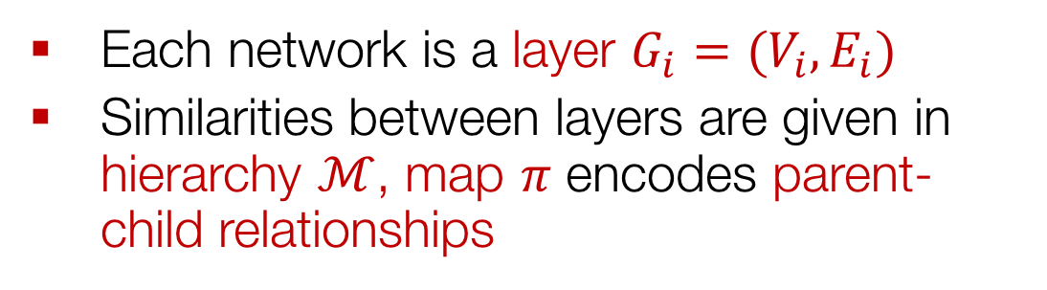
Multilayer Networks
Each network is a layer $G_{i}=(V_{i}, E_{i})$
Similarities between layers are given in hierarchy $ℳ$, map $π$ encodes parent-child relationships

Slide 52
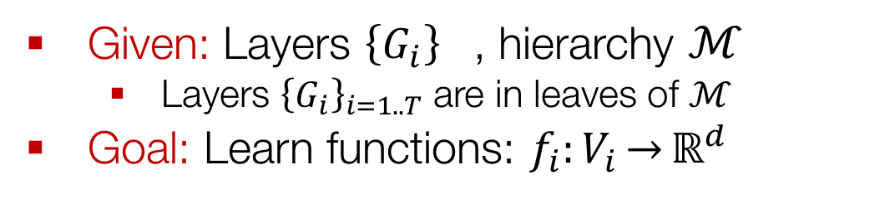
Multilayer Network Embeddings
Given: Layers ${\left\{G_{i}\right\}}_{}$, hierarchy $ℳ$
Layers ${\left\{G_{i}\right\}}_{i=1..T}$ are in leaves of $ℳ$
Goal: Learn functions: $f_{i}:V_{i}\overset{→}{}ℝ^{d}$
Nodes have different embeddings in different layers, but we want these embeddings to be related!

Slide 53
Multilayer Network Embeddings
Approach has two components:
Per-layer objectives: Standard node embedding objective (e.g., node2vec).
Hierarchical dependency objectives: Nodes in nearby layers in hierarchy are encouraged to share similar features

Slide 54
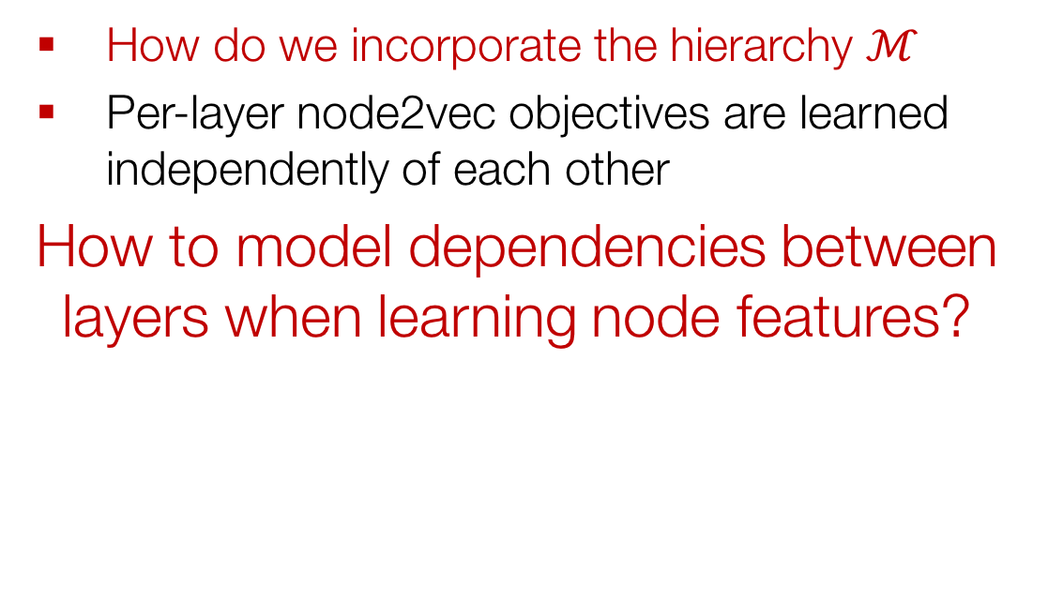
Interdependent Layers
How do we incorporate the hierarchy $ℳ$
Per-layer node2vec objectives are learned independently of each other
How to model dependencies between layers when learning node features?

Slide 55
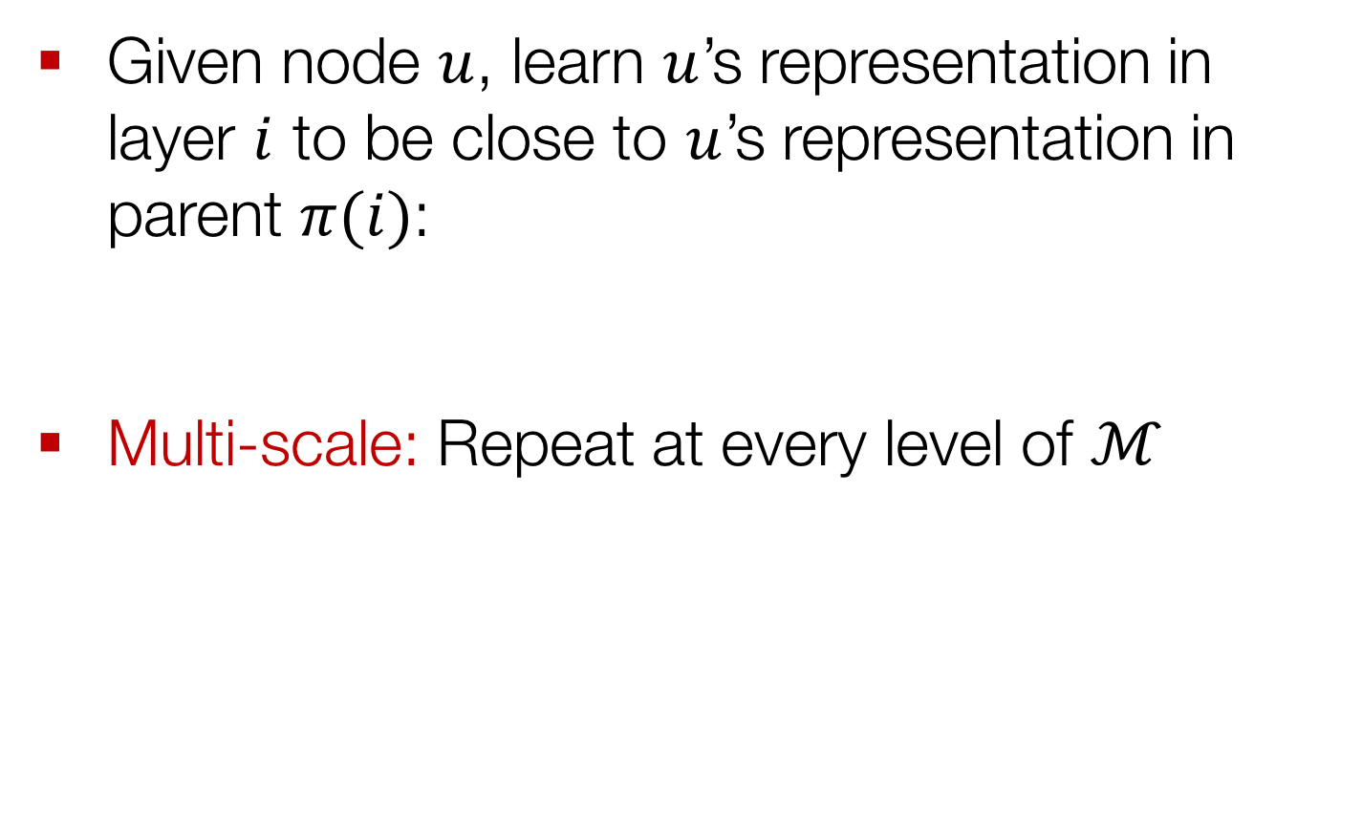
Interdependent Layers
Given node $u$, learn $u$’s representation in layer $i$ to be close to $u$’s representation in parent $π(i)$:
Multi-scale: Repeat at every level of $ℳ$
$L_{i}$ has all layers appearing in sub-hierarchy rooted at $i$

Slide 56
OhmNet: Final Model
Learning node features in multi-layer networks
Solve maximum likelihood problem:
Per-layer network objectives
Hierarchical dependency objectives

Slide 57
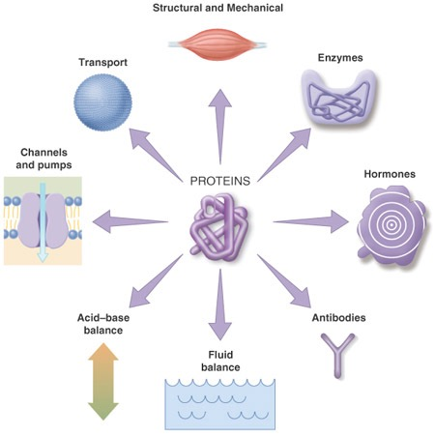
Experiments: Biological Nets
Proteins are worker molecules
Understanding protein function has great biomedical and pharmaceutical implications
107 genome-wide tissue-specific protein interaction networks
584 tissue-specific cellular functions
Examples (tissue, cellular function):
(renal cortex, cortex development)
(artery, pulmonary artery morphogenesis)

Slide 58
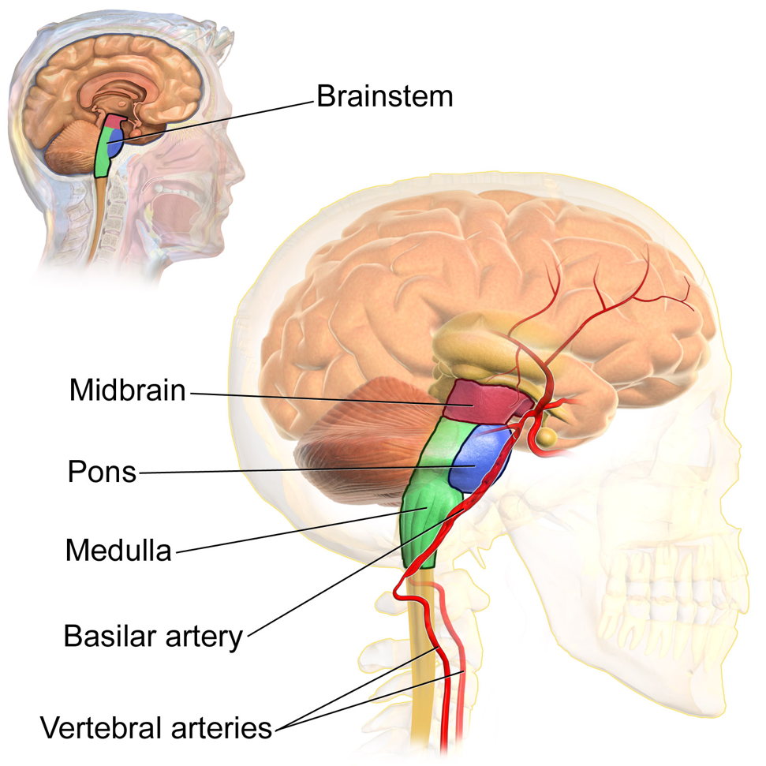
Brain Tissues
9 brain tissue PPI networks
in two-level hierarchy

Slide 59
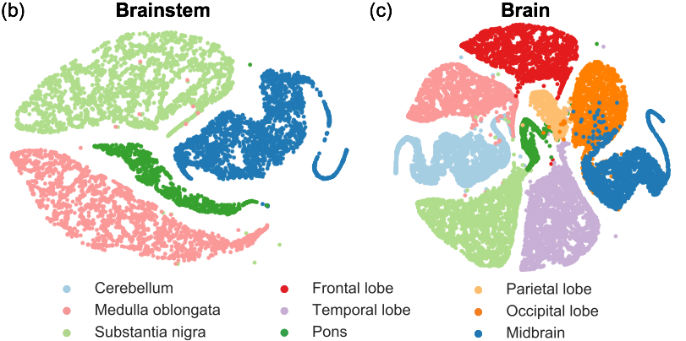

Meaningful Node Embeddings

